Slide 1
System Design & Analysis
Lecture 10

Slide 2
Object Oriented Design

Slide 3
Object Oriented Design
Uses object oriented decomposition
Takes input from object oriented analysis
Conceptual model
Behavior from use cases, activity diagram etc
User interface
High level abstractions from analysis and mapped onto classes
Association is formed between classes and objects
Uses notations to express different models of the system

Slide 4
Object Oriented Decomposition
Locate classes in the problem domain
Look for nouns in use cases e.g ATM, Bank, Account , etc
Find the operations
Appears as verbs in use case e.g Withdraw,CheckBalanace etc.
Determine the responsible classes for the operations
Requires a few iterations to locate the responsible classes
Identify and model associations
Build up the logical structure

Slide 5
Modeling Logical Structure
Use cases describe the behavior of the system
Activity diagram shows how to accomplish that behavior
UML provides class diagram
Provides information about class and their relationship
From part of the model’s logical view

Slide 6
Class Diagram
Describe the structure of the system
Represents a static view
Structure is described at the level of classes along with their relationship
The information is described without any particular implementation or object data
Helps documents different aspects of a system
Used to construct executable code for the application

Slide 7
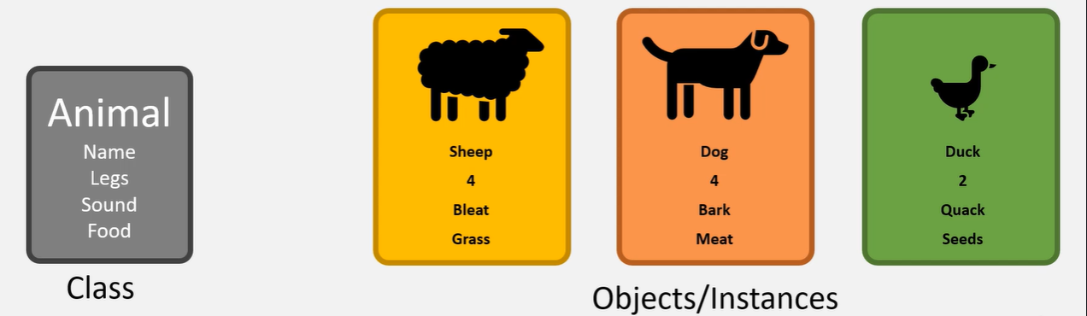
Class
A class is a type or blue print of an entity
Its instance is called as objects
An object of a class will represents a specific type

Slide 8
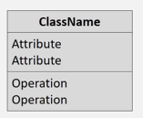
Classes in UML
Shown as a rectangle split into three sections
Top contains the name
Middle contains attributes
Bottom contains operations (methods)

Slide 9
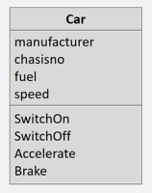
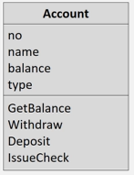
Example: Class

Slide 10
Class Names
10
ClassName
The name of the class is the only required tag in the graphical representation of a class. It always appears in the top-most compartment.
attributes
operations
Software Design (UML)

Slide 11
Class Attributes
11
Person
name : String
address : Address
birthdate : Date
ssn : Id
An attribute is a named property of a class that describes the object being modeled. In the class diagram, attributes appear in the second compartment just below the name-compartment.

Slide 12
Class Attributes (Cont’d)
12
Person
Attributes are usually listed in the form:
attributeName : Type
A derived attribute is one that can be computed from other attributes, but doesn’t actually exist. For example, a Person’s age can be computed from his birth date. A derived attribute is
designated by a preceding ‘/’ as in:
/ age : Date
name : String
address : Address
birthdate : Date
/ age : Date
ssn : Id

Slide 13
Class Attributes (Cont’d)
13
Person
+ name : String
# address : Address
# birthdate : Date
/ age : Date
- ssn : Id
Attributes can be:
+ public
# protected
- private
/ derived
Software Design (UML)

Slide 14
Class Operations
14
Person
name : String
address : Address
birthdate : Date
ssn : Id
eat
sleep
work
play
Operations describe the class behavior
and appear in the third compartment.

Slide 15
Class Operations (Cont’d)
15
PhoneBook
newEntry (n : Name, a : Address, p : PhoneNumber, d : Description)
getPhone ( n : Name, a : Address) : PhoneNumber
You can specify an operation by stating its signature: listing the name, type, and default value of all parameters, and, in the case of functions, a return type.
Software Design (UML)

Slide 16
Depicting Classes
16
When drawing a class, you needn’t show attributes and operation in every diagram.
Person
Person
Person
name : String
birthdate : Date
ssn : Id
Person
name
address
birthdate
eat()
sleep()
work()
play()
Person
eat
play

Slide 17
Class Responsibilities
17
A class may also include its responsibilities in a class diagram.
A responsibility is a contract or obligation of a class to perform a particular service.
SmokeAlarm
Responsibilities
-- sound alert and notify guard station
when smoke is detected.
-- indicate battery state

Slide 18
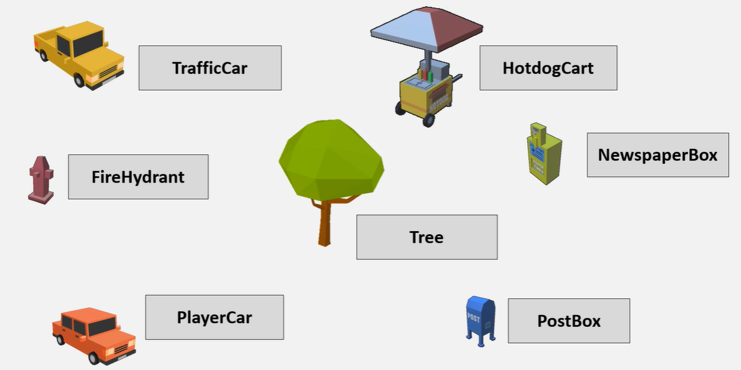
Objects in Reckless Driver

Slide 19
Relationships
19
In UML, object interconnections (logical or physical), are modeled as relationships.
There are three kinds of relationships in UML:
dependencies
generalizations
associations
Software Design (UML)

Slide 20
Dependency Relationships
20
A dependency indicates a semantic relationship between two or
more elements. The dependency from CourseSchedule to Course exists because Course is used in both the add and remove operations of CourseSchedule.
CourseSchedule
Course
add(c : Course)
remove(c : Course)
Software Design (UML)

Slide 21
Generalization Relationships
21
Person
A generalization connects a subclass to its superclass. It denotes an inheritance of attributes and behavior from the superclass to the subclass and indicates a specialization in the subclass of the more general superclass.
Student
Software Design (UML)

Slide 22
Generalization Relationships (Cont’d)
22
UML permits a class to inherit from multiple superclasses, although some programming languages (e.g., Java) do not permit multiple inheritance.
Student
Employee
TeachingAssistant
Software Design (UML)

Slide 23
Association Relationships
23
If two classes in a model need to communicate with each other, there must be link between them.
An association denotes that link.
Student
Instructor
Software Design (UML)

Slide 24
Association Relationships (Cont’d)
24
We can indicate the multiplicity of an association by adding multiplicity adornments to the line denoting the association.
The example indicates that a Student has one or more Instructors:
Student
Instructor
1..*
Software Design (UML)

Slide 25
Association Relationships (Cont’d)
25
The example indicates that every Instructor has one or more Students:
Student
Instructor
1..*
Software Design (UML)

Slide 26
Association Relationships (Cont’d)
26
We can also indicate the behavior of an object in an association (i.e., the role of an object) using rolenames.
teaches
learns from
Student
Instructor
1..*
1..*
Software Design (UML)

Slide 27
Association Relationships (Cont’d)
27
We can also name the association.
membership
Student
Team
1..*
1..*
Software Design (UML)

Slide 28
Association Relationships (Cont’d)
28
We can specify dual associations.
member of
Student
Team
1..*
1..*
1
president of
1..*
Software Design (UML)

Slide 29
Association Relationships (Cont’d)
29
We can constrain the association relationship by defining the navigability of the association. Here, a Router object requests services from a DNS object by sending messages to (invoking the operations of) the server. The direction of the association indicates that the server has no knowledge of the Router.
Router
DomainNameServer
Software Design (UML)

Slide 30
Association Relationships (Cont’d)
30
Associations can also be objects themselves, called link classes or an association classes.
Registration
modelNumber
serialNumber
warrentyCode
Product
Warranty
Software Design (UML)

Slide 31
Association Relationships (Cont’d)
31
A class can have a self association.
next
LinkedListNode
previous
Software Design (UML)

Slide 32
Association Relationships (Cont’d)
32
We can model objects that contain other objects by way of special associations called aggregations and compositions.
An aggregation specifies a whole-part relationship between an aggregate (a whole) and a constituent part, where the part can exist independently from the aggregate. Aggregations are denoted by a hollow-diamond adornment on the association.
Car
Engine
Transmission
Software Design (UML)

Slide 33
Association Relationships (Cont’d)
33
A composition indicates a strong ownership and coincident lifetime of parts by the whole (i.e., they live and die as a whole). Compositions are denoted by a filled-diamond adornment on the association.
Window
Scrollbar
1
1
Titlebar
1
1
Menu
1
1 .. *
Software Design (UML)

Slide 34
Interfaces
34
An interface is a named set of operations that specifies the behavior of objects without showing their inner structure. It can be rendered in the model by a one- or two-compartment rectangle, with the stereotype <<interface>> above the interface name.
<<interface>>
ControlPanel
Software Design (UML)

Slide 35
Interface Services
35
<<interface>>
ControlPanel
Interfaces do not get instantiated. They have no attributes or state. Rather, they specify the services offered by a related class.
getChoices : Choice[]
makeChoice (c : Choice)
getSelection : Selection
Software Design (UML)

Slide 36
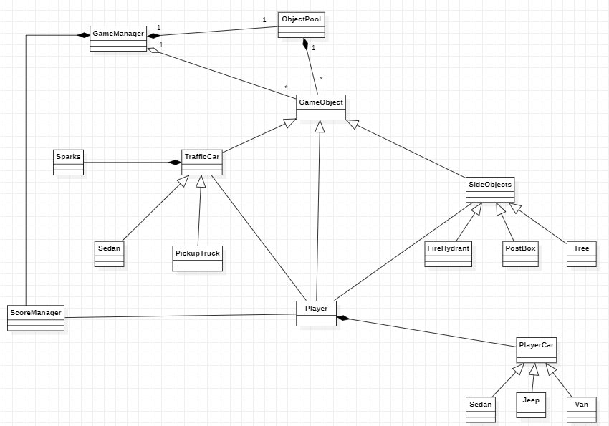
36

